Slide 1
SOLID
Joseph Patarcity
joseph.patarcity@rutgers.edu

Slide 2
The SOLID Principle of Object Oriented Design
First introduced by Robert C. Martin in Design Principles and Design Patterns
Expanded by Michael Feathers (who introduced the SOLID acronym)
Encourages creation of maintainable, understandable and flexible software
Complexity can be reduced as applications grow

Slide 3
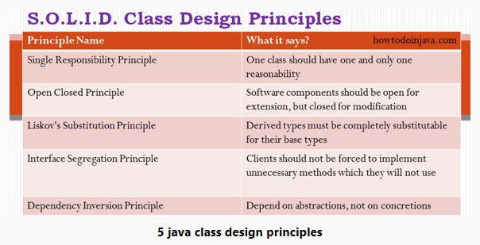

Slide 4
Single Responsibility Principle
A class should have only one responsibility, and only one reason to change
Fewer test cases
Lower coupling (simpler classes have fewer dependencies)
Well organized and readable

Slide 5
Open Closed Principle
A class should be open to extension, but closed to modification
This limits the opportunity for introducing new defects
An exception to this rule fixing defects (code modification is a necessity)

Slide 6
Liskov’s Substitution Principle
If class B is a sub-class of class A, then interchanging A and B should not to change the behavior of an application

Slide 7
Interface Segregation Principle
Large class interfaces should be separated into smaller interfaces
This insures class implementations need only be concerned with methods that they are interested in

Slide 8
Dependency Inversion Principle
This principle refers to decoupling of software modules; rather than a high-level module depending on a low-level module, both modules should depend on abstraction

Slide 9
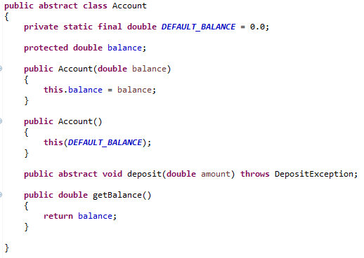
SOLID
This Java class applies the following SOLID principles.
Single Responsibility Principle.
The abstract Account class only operates on balance, to initialize it, return it, and modify it through deposit().
Open Closed Principle
This class allows derived classes to change the behavior of deposit().
Liskov’s Substitution Principle
Any derived class can be substituted for this abstract class, and derived classes are interchangable
Interface Segregating Principle
No method besides deposit() need be implemented by a class extending this class.

Slide 10
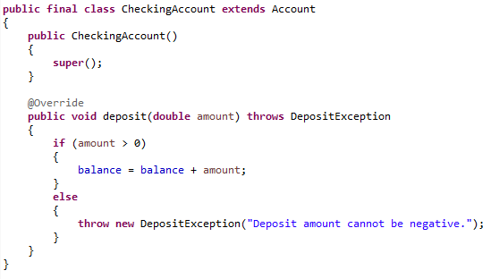
SOLID
This Java class applies the following SOLID principles.
Dependency Inversion Principle – This class depends on Account, which is abstract, rather than concrete.
Notes:
Special Note; this class is declared as final. This means that NO OTHER class can be derived from the CheckingAccount class. This has two purposes … 1) By design of the system, making this class final means conceptually there are no other types of checking accounts and 2) it protects this class from known Java vulnerabilities.

Slide 11
SOLID
Review the SOLID principles for Java here …
https://howtodoinjava.com/best-practices/5-class-design-principles-solid-in-java/

